Slide 1
Beta Meeting
November 6th, 2024

Slide 2
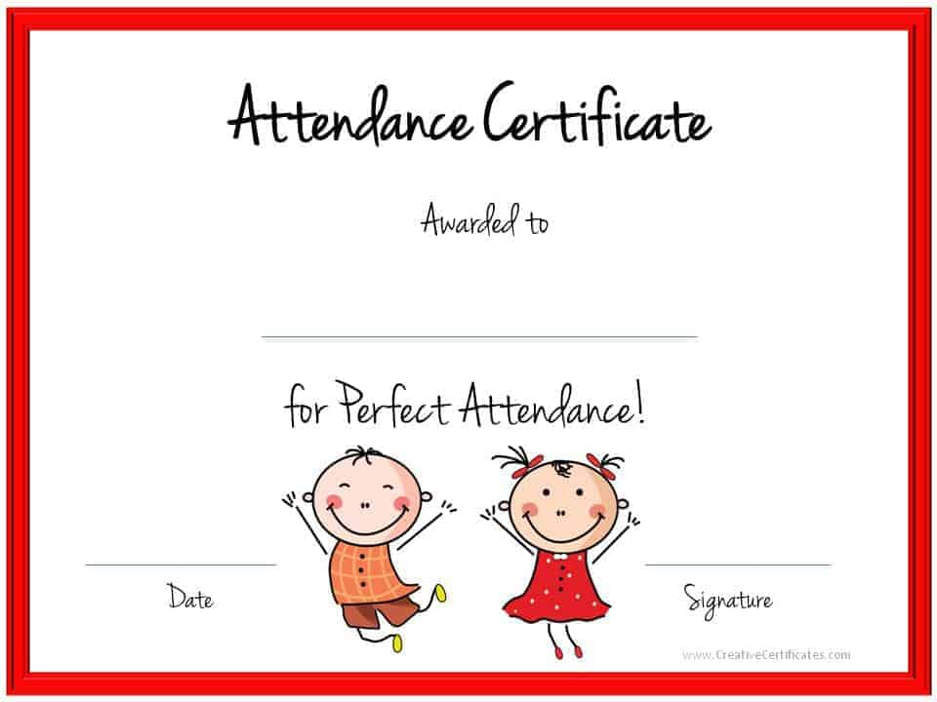
Good morning!
Open Remind and fill out the Microsoft form to take attendance
This Photo by Unknown Author is licensed under CC BY-SA

Slide 3

*Coffee will be ready for pick up
on Wednesday 11/13 in room 5119, Mrs. Taylor’s old room
*Coffee must be picked up afterschool any day that week.

Slide 4
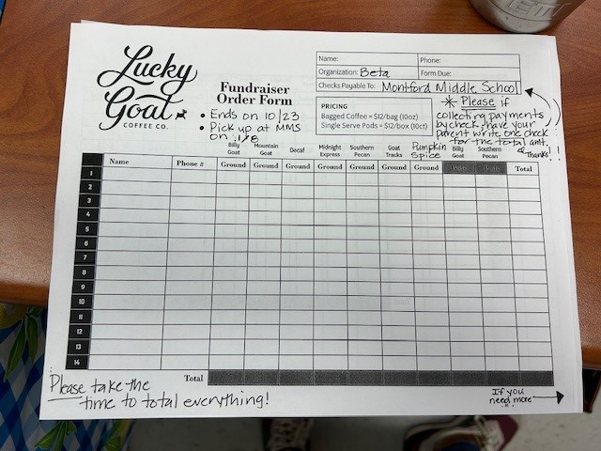
TOGETHER WE RAISED-
0ver $2000.00 for Relay for Life!
CONGRATULATIONS TO THE FOLLOWING SELLERS!
3. Noah Jaworski- 27 bags
2. Lindsey Mathis- 28 bags
1. Jacob DeGraw – 42 bags

Slide 6

WHAT’S NEXT?
Beta will be collecting items for Blessing Bags during the week of 11/18. Items may be placed in the front office Blessing Bags box. You will earn 1 hour for each 5 items you bring.
Acceptable items?
Travel Size Shampoo and Conditioner
Travel Size Body Soap/ Hand Sanitizer
Travel Size Toothpaste/Mouthwash
Toothbrushes
Travel Size Body Lotion
Small Tissues/ Body Wipes
Chapstick
Individually Wrapped Snacks

Slide 7

DUE TO TESTING WE WILL NOT HAVE A DECEMBER MEETING!

